Slide 1
C Program, Variables, Data types, sizes and constants

Slide 2
Objectives
To learn and appreciate
General Structure of C program
C Tokens
Variables
Declarations
Data Types and Sizes
Arithmetic Operators
Relational and Logical Operators
Type conversions
Increment and Decrement Operators
Bitwise Operators
Assignment Operators and Conditional Expressions
Precedence and Order of Evaluation

Slide 3
Session outcome
At the end of session student will be able to learn and understand
General structure of C program
C Tokens
Variables
Declarations
Data Types and Sizes
Arithmetic Operators
Relational and Logical Operators
Type conversions
Increment and Decrement Operators
Bitwise Operators
Assignment Operators and Conditional Expressions
Precedence and Order of Evaluation

Slide 4
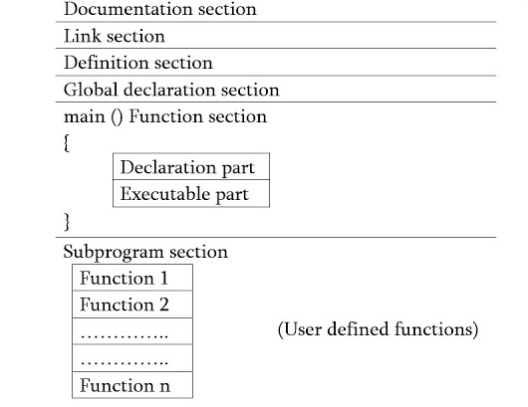
General Structure of C program

Slide 5
C program for reading a number and display it on the screen
//Program to read and display a number
#include<stdio.h>
int main()
{
int num;
printf("\nEnter the number: ");
scanf("%d", &num);
printf(“The number read is: %d", num);
return(0);
}

Slide 6
Adding two integers
#include <stdio.h>
int main( void )
{/* start of function main */
int sum; /* variable in which sum will be stored */
int integer1; /* first number to be input by user */
int integer2; /* second number to be input by user */
printf( "Enter first integer\n" );
scanf( "%d", &integer1 ); /* read an integer */
printf( "Enter second integer\n" );
scanf( "%d", &integer2 ); /* read an integer */
sum = integer1 + integer2; /* assign total to sum */
printf( "Sum is %d\n", sum ); /* print sum */
return 0; /* indicate that program ended successfully */
} /* end of function main */

Slide 7
C Character set
Character set is a set of valid characters that a language can recognize.
C character set consists of letters, digits, special characters, white spaces.
Letters → ‘a’, ‘b’, ‘c’,………..’z’ Or ‘A’, ‘B’, ‘C’,……….’Z’
Digits → 0, 1, 2,……………………9
Special characters → ;, ?, >, <, &,{, }, [, ]……
White spaces → New line (\n), Tab(\t), Vertical Tab(\v) etc

Slide 8
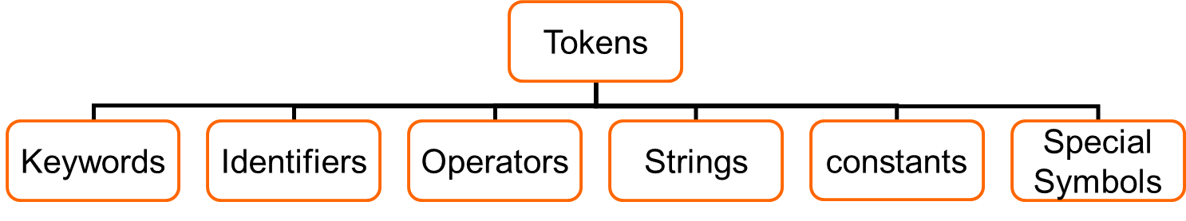
C Tokens
A token is a group of characters that logically belong together.
The programmer writes a program by using tokens.
C uses the following types of tokens.
break
int
float
…
Variable
Constant
Function name
Array name
…
+
*
%
…
“hello”
“123”
“s”
…
124
21.3
‘A’
‘9’
“hello”…
;
?
>
&{
}
Notes:
In a passage of text, individual words and punctuation marks are called tokens.
Similarly in a C program the smallest individual units are known as tokens.

Slide 9
Keywords
These are some reserved words in C which have predefined meaning to compiler called keywords.
Keywords are not to be used as variable and constant names.
All keywords have fixed meanings and these meanings cannot be changed.

Slide 10
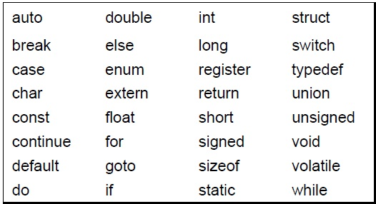
Compiler specific keywords
Some commonly used keywords are given below:

Slide 11
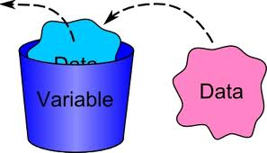
Variables
Variables are data storage locations in the computer’s memory.

Slide 12
Variables
Variables are the symbolic names for storing computational data.
Variable: a symbolic name for a memory location
In C variables have to be declared before they are used
Ex: int x
A variable may take different values at different times during execution.
Declarations reserve storage for the variable.
Value is assigned to the variable by initialization or assignment

Slide 13
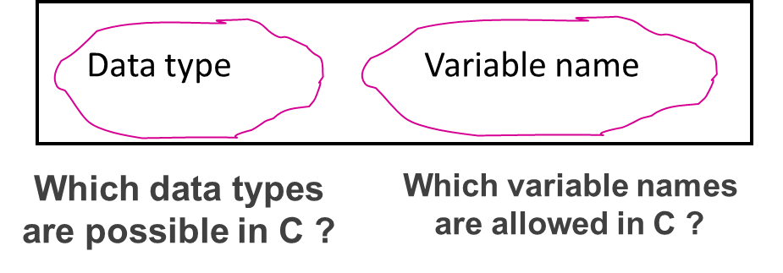
Variable declarations

Slide 14
Variable Names- Identifiers
Symbolic names can be used in C for various data items used by a programmer.
A symbolic name is generally known as an identifier. An identifier is a name for a variable, constant, function, etc.
The identifier is a sequence of characters taken from C character set.

Slide 15
Variable names
Rules for valid variable names (identifiers) :
Name must begin with a letter or underscore ( _ ) and can be followed by any combination of letters, underscores, or digits.
Key words cannot be used as a variable name.
C is case-sensitive: sum, Sum, and SUM each refer to a different variable.
Variable names can be as long as you want, although only the first 63 (or 31) characters might be significant.
Choice of meaningful variable names can increase the readability of a program

Slide 16
Variable names
Examples of valid variable names:
1) Sum
2) _difference
3) a
4) J5x7
5) Number_of_moves
Examples of invalid variable names:
1) sum$value
2) 3val
3) int

Slide 17
Declaring variables
C imposes to declare variables before their usage.
Advantages of variable declarations:
Putting all the variables in one place makes it easier for a reader to understand the program.
Thinking about which variables to declare encourages the programmer to do some planning before writing a program.
The obligation to declare all variables helps prevent bugs of misspelled variable names.
Compiler knows the amount of memory needed for storing the variable.
Compiler can verify that operations done on a variable are allowed by its type.

Slide 18
Primary (built-in or Basic)Data types
INTEGER
CHARACTER
SIGNED TYPE UNSIGNED TYPE
INT UNSIGNED INT
SHORT INT UNSIGNED SHORT INT
LONG INT UNSIGNED LONG INT
SIGNED CHARACTER
UNSIGNED CHARACTER
FLOATING POINT TYPE
VOID
FLOATING POINT TYPE
FLOAT
DOUBLE
LONG DOUBLE
VOID

Slide 19
Data types
Basic data types: int, float, double, char, and void.
int: can be used to store integer numbers (values with no decimal places).
float: can be used for storing floating-point numbers (values containing decimal places).
double: the same as type float, and roughly twice the size of float.
char: can be used to store a single character, such as the letter a, the digit character 6, or a semicolon.
void: is used to denote nothing or empty.

Slide 20
Using and Displaying Variables
#include <stdio.h>
int main ()
{
int sum;
sum = 50 + 25;
cout<<"The sum of 50 and 25 is “<<sum;
return 0;
}
Variable sum declared of type int
Variable sum assigned expression 50+25
Value of variable sum is printed
The cout has now 2 arguments: first argument a string, and the second that holds variable with integer value of summation.

Slide 21
Variables - Examples
int a; // declaring a variable of type int
int sum, a1, a2; // declaring 3 variables
int x = 7; // declaring and initializing a variable
a = 5; // assigning to variable a the value 5
a1 = a; // assigning to variable a1 the value of a
L-value
R-value
a1=a1+1; // assigning to variable a1 the value of a1+1
// (increasing value of a1 with 1)

Slide 22
Integer Types
The basic integer type is int
The size of an int depends on the machine and on PCs it is normally 16 or 32 or 64 bits.
modifiers (type specifiers)
short: typically uses less bits
long: typically uses more bits
Signed: both negative and positive numbers
Unsigned: only positive numbers

Slide 23
Size and Range of values for 16-bit Machine (Integer type)
 | Type | Size | Range
short | short int or signed short int | 8 | -128 to 127
 | unsigned int | 8 | 0 to 255
Integer | int or signed int | 16 | -32,768 to 32,767
 | unsigned int | 16 | 0 to 65,535
Long | long int or signed long int | 32 | -2,147,483,648 to 2,147,483,647
 | unsigned long int | 32 | 0 to 4,294,967,295

Slide 24
The char type
A char variable can be used to store a single character.
A character constant is formed by enclosing the character within a pair of single quotation marks. Valid examples: 'a’ .
Character zero ( ‘0’ ) is not the same as the number (integer constant) 0.
The character constant ‘\n’—the newline character—is a valid character constant. It is called as an escape character.
There are other escape sequences like, \t for tab, \v for vertical tab, \n for new line etc.

Slide 25
Character Types
Character type char is related to the integer type.
Modifiers(type specifiers) unsigned and signed can be used
char →1 byte (-128 to 127)
signed char →1 byte (-128 to 127)
unsigned char →1 byte (0 to 255)
ASCII (American Standard Code for Information Interchange ) is the dominant encoding scheme for characters.
Examples
' ' encoded as 32 '+' encoded as 43
'A' encoded as 65 …………………….'Z' encoded as 90
'a' encoded as 97 ……………………. 'z' encoded as 122
‘0’ encoded as 48 ……………………..’9’ encoded as 57

Slide 26
Assigning values to char
char letter; /* declare variable letter of type char */
letter = ‘A'; /* OK */
letter = A; /* NO! Compiler thinks A is a variable */
letter = “A"; /* NO! Compiler thinks “A" is a string */ letter = 65; /* ok because characters are internally stored as numeric values (ASCII code) */

Slide 27
Floating-Point Types
Floating-point types represent real numbers
Integer part
Fractional part
The number 108.1517 breaks down into the following parts
108 - integer part
1517 - fractional part
Floating-point constants can also be expressed in scientific notation. The value 1.7e4 represents the value 1.7 × 10⁴.
The value before the letter e is known as the mantissa, whereas the value that follows e is called the exponent.
There are three floating-point type specifiers
float
double
long double
Notes:
IEEE Standard for Floating-Point Arithmetic (IEEE 754)

Slide 28
SIZE AND RANGE OF VALUES FOR 16-BIT MACHINE (FLOATING POINT TYPE)
 | Type | Size
Single Precision | Float | 32 bits 4 bytes
Double Precision | double | 64 bits 8 bytes
Long Double Precision | long double | 80 bits 10 bytes

Slide 29
void
2 uses of void are
To specify the return type of a function when it is not returning any value.
To indicate an empty argument list to a function.

Slide 30
Best Practices for Programming
Naming Variables According to Standards
Prefix Data Type Example
i int and unsigned int iTotalMarks
f float fAverageMarks
d double dSalary
l long and unsigned long lFactorial
c signed char and unsigned char cChoice
ai Array of integers aiStudentId
af Array of float afQuantity
ad Array of double adAmount
al Array of long integers alSample
ac Array of characters acEmpName

Slide 31
Example: Using data types
#include <stdio.h>
int main ()
{
int integerVar = 100;
float floatingVar = 331.79;
double doubleVar = 144368.4411;
char charVar = 'W';
printf(“%d\n”, integerVar);
printf(“%f\n”,floatingVar);
printf(“%g\n”,doubleVar);
printf(“%c\n”,charVar);
return 0;
}
Notes:
%d, %f format specifiers

Slide 32
Summary
We have learnt about
General Structure of C program
C Tokens
Variables
Declarations
Data Types and Sizes
Arithmetic Operators
Relational and Logical Operators
Type conversions
Increment and Decrement Operators
Bitwise Operators
Assignment Operators and Conditional Expressions
Precedence and Order of Evaluation

Slide 33
Objectives
To learn and appreciate
Arithmetic Operators
Relational and Logical Operators
Type conversions
Increment and Decrement Operators
Bitwise Operators
Assignment Operators and Conditional Expressions
Precedence and Order of Evaluation

Slide 34
Session outcome
At the end of session student will be able to learn and understand
Arithmetic Operators
Relational and Logical Operators
Type conversions
Increment and Decrement Operators
Bitwise Operators
Assignment Operators and Conditional Expressions
Precedence and Order of Evaluation

Slide 35
Operators
The different operators are:
Arithmetic
Relational
Logical
Increment and Decrement
Bitwise
Assignment
Conditional

Slide 36
Arithmetic Operators
The binary arithmetic operators are +, -, *, / and the modulus operator %.
The / operator when used with integers truncates any fractional part i.e. E.g. 5/2 = 2 and not 2.5
Therefore % operator produces the remainder when 5 is divided by 2 i.e. 1
The % operator cannot be applied to float or double
E.g. x % y wherein % is the operator and x, y are operands

Slide 37
The unary minus operator
#include <stdio.h>
int main ()
{
int a = 25;
int b = -2;
printf(“%d\n”,-a);
printf(“%d\n”,-b);
return 0;
}

Slide 38
Working with arithmetic expressions
Basic arithmetic operators: +, -, *, /, %
Precedence: One operator can have a higher priority, or precedence, over another operator. The operators within C are grouped hierarchically according to their precedence (i.e., order of evaluation)
Operations with a higher precedence are carried out before operations having a lower precedence.
High priority operators * / %
Low priority operators + -
Example: * has a higher precedence than +
a + b * c → a+(b*c)
If necessary, you can always use parentheses in an expression to force the terms to be evaluated in any desired order.
Associativity: Expressions containing operators of the same precedence are evaluated either from left to right or from right to left, depending on the operator. This is known as the associative property of an operator.
Example: + has a left to right associativity
For both the precedence group described above, associativity is “left to right”.

Slide 39

Working with arithmetic expressions
#include <stdio.h>
int main ()
{
int a = 100;
int b = 2;
int c = 25;
int d = 4;
int result;
result = a * b + c * d;
printf(“ Result1: %d\n”,result);
result = a * (b + c * d);
printf(“ Result2: %d\n”,result);
return 0;
}

Slide 40
Relational operators
Operator | Meaning
== | Is equal to
!= | Is not equal to
< | Is less than
<= | Is less or equal
> | Is greater than
>= | Is greater or equal
The relational operators have lower precedence than all arithmetic operators:
a < b + c is evaluated as a < (b + c)
ATTENTION !
the “is equal to” operator == and the “assignment” operator =
Notes:
Operator Symbol Means Example
Equal == Is operand 1 equal to operand 2? x == y
Greater than > Is operand 1 greater than operand 2? x > y
Less than < Is operand 1 less than operand 2? x < y
Greater than >= Is operand 1 greater than or equal to operand 2? x >= y
Less than <= Is operand 1 less than or equal to operand 2? x <= y
Not equal != Is operand 1 not equal to operand 2? x != y

Slide 41
Relational operators
An expression such as a < b containing a relational operator is called a relational expression.
The value of a relational expression is one, if the specified relation is true and zero if the relation is false.
E.g.:
10 < 20 is TRUE
20 < 10 is FALSE
A simple relational expression contains only one relational operator and takes the following form.
ae1 relational operator ae2
ae1 & ae2 are arithmetic expressions, which may be simple constants, variables or combinations of them.

Slide 42
Relational operators
The arithmetic expressions will be evaluated first & then the results will be compared. That is, arithmetic operators have a higher priority over relational operators. > >= < <= all have the same precedence and below them are the next precedence equality operators i.e. == and !=
Suppose that i, j and k are integer variables whose values are 1, 2 and 3 respectively.
Expression Interpretation Value
i<j
(i+j)>=k
(j+k)>(i+5)
k!=3
j==2
true 1
true 1
false 0
false 0
true 1

Slide 43
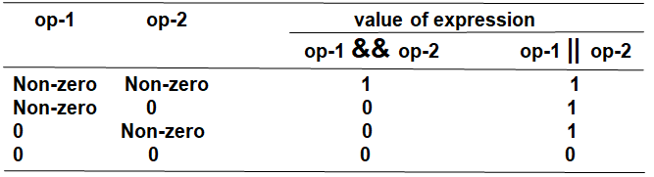
Logical operators
Truth Table
Operator | Symbol | Example
AND | && | expression1 && expression2
OR | || | expression1 || expression2
NOT | ! | !expression1
The result of logical operators is always either 0 (FALSE) or 1 (TRUE)

Slide 44
Logical operators
Expressions | Evaluates As
(5 == 5)&&(6 != 2) | True (1) because both operands are true
(5 > 1) || (6 < 1) | True (1) because one operand is true
(2 == 1)&&(5 ==5) | False (0) because one operand is false
! (5 == 4) | True (1) because the operand is false
!(FALSE) = TRUE !(TRUE) = FALSE

Slide 45
Increment and Decrement operators (++ and -- )
The operator ++ adds 1 to the operand.
The operator -- subtracts 1 from the operand.
Both are unary operators.
Ex: ++i or i++ is equivalent to i=i+1
They behave differently when they are used in expressions on the R.H.S of an assignment statement.
Notes:
You can put the ++/-- before or after the operand. If it appears before the operand, the operand is incremented/decremented. The incremented value is then used in the expression. If you put the ++/-- after the operand, the value of the operand is used in the expression before the operand is incremented/decremented.

Slide 46
Increment and Decrement operators
Ex:
m=5;
y=++m; Prefix Mode
m=5;
y=m++; Postfix Mode
Prefix operator ++ appears before the variable.
Postfix operator ++ appears after the variable.
In this case, the value of y and m would be 6.
Here y continues to be 5. Only m changes to 6.
Notes:
++x and --y are called prefix mode, that means the increment or decrement operators modify their operand before it is used.
x++ and y-- are called postfix mode, the increment or decrement operators modify their operand after it is used. Remember the before used and after used words.
For example:
Postfix mode:
x = 10;
y = x++;
After these statements are executed, x = 11, y has the value of 10, the value of x was assigned to y, and then x was incremented.
Prefix mode:
y = 10;
y = ++x;
Both y and x having the value of 11, x is incremented, and then its value is assigned to y.

Slide 47
Increment and Decrement operators
Don’ts:
Attempting to use the increment or decrement operator on an expression other than a modifiable variable name or reference.
Example:
++(5) is a syntax error
++(x + 1) is a syntax error

Slide 48
Bitwise Operators
Bitwise Logical Operators
Bitwise Shift Operators
Ones Complement operator

Slide 49
Bitwise Logical operators
&(AND),|(OR),^(EXOR)
These are binary operators and require two integer operands.
These work on their operands bit by bit starting from LSB (rightmost bit).
op1 | op2 | & | | | ^
1 | 1 | 1 | 1 | 0
1 | 0 | 0 | 1 | 1
0 | 1 | 0 | 1 | 1
0 | 0 | 0 | 0 | 0
Notes:
Bitwise operators used to manipulate the bits of integral operands, to modify the individual bits (bit by bit) rather than the number itself. Both operands in a bitwise expression must be of an integral type.
Below is the list of the bitwise operators.
Operator Description
& (ampersand - bitwise AND) The bit in the result are set to 1 if the corresponding bits in the two operands are both 1, otherwise it returns 0.
| (pipe - bitwise inclusive OR) The bit in the result is set to 1 if at least one (either or both) of the corresponding bits in the two operands is 1,
otherwise it returns 0.
^ (caret - bitwise exclusive OR) The bit in the result is set to 1 if exactly one of the corresponding bits in the two operands is 1.

Slide 50
Example
Suppose x = 10, y = 15
z = x & y sets z=10 like this
0000000000001010 ← x
0000000000001111 ← y
0000000000001010 ← z = x & y
Same way |,^ according to the table are computed.

Slide 51
Bitwise Shift operators
<<, >>
These are used to move bit patterns either to the left or right.
They are used in the following form
op<<n or op>>n here op is the operand to be shifted and n is number of positions to shift.
Notes:
Operators Description
<< (bitwise shift left) Moves the bit of the first operand to the left by the number of bits specified by the second operand; it discards the far left bit ; fill
from the right with 0 bits.
>> (bitwise shift right) Moves the bit of the first operand to the right by the number of bits specified by the second operand; discards the far right bit; fill
from the right with 0 bits.

Slide 52
Bitwise Shift operator: <<
<< causes all the bits in the operand op to be shifted to the left by n positions.
The leftmost n bits in the original bit pattern will be lost and the rightmost n bits that are vacated are filled with 0’s

Slide 53
Bitwise Shift operator: >>
>> causes all the bits in operand op to be shifted to the right by n positions.
The rightmost n bits will be lost and the left most vacated bits are filled with 0’s if number is unsigned integer

Slide 54
Examples
Suppose X is an unsigned integer whose bit pattern is 0000 0000 0000 1011
x<<1 0000 0000 0001 0110
x>>1 0000 0000 0000 0101
Add ZEROS
Add ZEROS

Slide 55
Examples
Suppose X is an unsigned integer whose bit pattern is 0000 0000 0000 1011 whose equivalent value in decimal number system is 11.
x<<3 0000 0000 0101 1000 = 88
x>>2 0000 0000 0000 0010 = 2
Note:
x=y<<1; same as x=y*2 (Multiplication)
x=y>>1; same as x=y/2 (Division)
Add ZEROS
Add Z EROS
Notes:
Another example for <<, lets say the variable declaration is:
unsigned int p = 5;
In binary, p = 00000000 00000101
For p<<1 in binary,
00000000 00000101 << 1 = 00000000 00001010 = 10 decimal
For p<<2 in binary,
00000000 00000101 << 2 = 00000000 00010100 = 20 decimal
Example for >>:
unsigned int p = 40960, for 16 bits,
In binary, p = 10100000 00000000
For p >> 1 in binary,
10100000 00000000 >> 1 = 01010000 00000000 = 20480 decimal
For p>>3 in binary,
10100000 00000000 >> 3 = 00010100 00000000 = 5120 decimal

Slide 56
Bitwise Shift operators
Op and n can be constants or variables.
There are 2 restrictions on the value of n
n cannot be –ve
n should not be greater than number of bits used to represent Op.(E.g.: suppose op is int and size is 2 bytes then n cannot be greater than 16).

Slide 57
Bitwise complement operator
The complement operator(~) is an unary operator and inverts all the bits represented by its operand.
Suppose x=1001100010001111
~x=0110011101110000 (complement)
Also called as 1’s complement operator.
Notes:
Operator Description
~ (tilde - bitwise complement) Negation. 0 bit set to 1, and 1 bit set to 0. Also used to create destructors.

Slide 58
Type Conversions in Expressions
C permits mixing of constants and variables of different types in an expression
C automatically converts any intermediate values to the proper type so that the expression can be evaluated without losing any significance.
This automatic conversion is known as implicit type conversion
The table in the next slide gives the implicit type conversions

Slide 59
Type Conversions in Expressions
The following are the sequence of rules that are applied while evaluating expressions
Lower Type Operands | Higher Type Operands
Short or Char | int
One operand is Long double, the other will be converted to long double | Result is also long double
One operand is double, the other will be converted to double | Result is also double
One operand is float, the other will be converted to float | Result is also float
One operand is unsigned Long int, the other will be converted to unsigned long int | Result is also unsigned long int
Notes:
When different operands of an expression are of different type, complier performs implicit type conversion to match them. Below are the rules followed by compiler to perform the implicit conversion.
Integer Promotion: All types lower than int (char, short etc) are first promoted to int.
If the types of operands differ even after integer promotion, then following actions are taken
If one of the operand is long double, convert all others to long double
If one of the operand is double, convert all others to double
If one of the operand is float, convert all others to float
If one of the operand is float, convert all others to float
... This operation proceeds from the highest type to lowest. Order of the data types from highest to lowest is given below
long double > double > float > unsigned long long > long long > unsigned long > long > unsigned int > int

Slide 60
Type Conversions in Expressions
Lower Type Operands | Higher Type Operands
One operand is Long int, and the other is unsigned int then a) If unsigned int can be converted to long int the unsigned int operand will be converted b) Else both operands will be converted to unsigned long int | Result will be long int Result will be unsigned long int
One operand is Long int, the other will be converted to long int | Result is also long int
Notes:
When different operands of an expression are of different type, complier performs implicit type conversion to match them. Below are the rules followed by compiler to perform the implicit conversion.
Integer Promotion: All types lower than int (char, short etc) are first promoted to int.
If the types of operands differ even after integer promotion, then following actions are taken
If one of the operand is long double, convert all others to long double
If one of the operand is double, convert all others to double
If one of the operand is float, convert all others to float
If one of the operand is float, convert all others to float
... This operation proceeds from the highest type to lowest. Order of the data types from highest to lowest is given below
long double > double > float > unsigned long long > long long > unsigned long > long > unsigned int > int

Slide 61
Type Conversions in Expressions
The final result of an expression is converted to the type of the variable on the left of the assignment sign before assigning the value to it
However the following changes are introduced during the final assignment
Float to int causes truncation of the fractional part
Double to float caused rounding of digits
Long int to int causes dropping of the excess higher order bits

Slide 62
Type Conversions in Expressions
Explicit type conversion or type casting
There are instances when we want to force a type conversion in a way that is different from the automatic conversion
E.g. ratio=57/67
Since 57 and 67 are integers in the program , the decimal part of the result of the division would be lost and ratio would represent a wrong figure
This problem can be solved by converting locally as one of the variables to the floating point as shown below:
ratio= (float) 57/67

Slide 63
Type Conversions in Expressions
The operator (float) consider 57 for computation to floating point then using the rule of automatic conversion
The division is performed in floating point mode, thus retaining the fractional part of result
The process of such a local conversion is known as explicit conversion or casting a value

Slide 64
The Type Cast Operator
The general form of a type casting is
(type-name) expression
int a =150; float f; f = (float)a / 100; // type cast operator
The type cast operator has the effect of converting the value of the variable ‘a’ to type float for the purpose of evaluation of the expression.
This operator does NOT permanently affect the value of the variable ‘a’;
The type cast operator has a higher precedence than all the arithmetic operators except the unary minus and unary plus.
Examples of the use of type cast operator:
(int) 29.55 + (int) 21.99 results in 29 + 21
(float)6 /(float)4 results in 1.5
(float)6 / 4 results in 1.5

Slide 65
Type Conversions in Expressions
Example | Action
x=(int) 7.5 | 7.5 is converted to integer by truncation
a=(int) 21.3/(int)4.5 | Evaluated as 21/4 and the result would be 5
b=(double)sum/n | Division is done in floating point mode
y=(int)(a+b) | The result of a+b is converted to integer
z=(int)a+b | a is converted to integer and then added to b
p= cos((double)x) | Converts x to double before using it

Slide 66
Integer and Floating-Point Conversions
Assign an integer value to a floating variable: does not cause any change in the value of the number; the value is simply converted by the system and stored in the floating format.
Assign a floating-point value to an integer variable: the decimal portion of the number gets truncated.
Integer arithmetic (division):
int divided by int => result is integer division
int divided by float or float divided by int => result is real division (floating-point)

Slide 67
Integer and Floating-Point Conversions
#include <stdio.h>
int main ()
{ float f1 = 123.125, f2;
int i1, i2 = -150;
i1 = f1; // float to integer conversion
printf (“float assigned to int produces”);
printf(“%d\n”,i1);
f2 = i2; // integer to float conversion
printf(“integer assigned to float produces”);
print(“%.2f\n”,f2);
i1 = i2 / 100; // integer divided by integer
printf(“integer divided by integer produces”);
printf(“%d\n”,i1);
f1 = i2 / 100.0; // integer divided by a float
printf(“integer divided by float produces”);
printf(“%.2f\n”,f1);
return 0;
}
123
-150.00
-1
-1.50

Slide 68
The assignment operators
The C language permits you to join the arithmetic operators with the assignment operator using the following general format: op=, where op is an arithmetic operator, including +, –, *, /, and %.
Example:
count += 10;
Equivalent to:
count=count+10;
Example: precedence of op=:
a /= b + c
Equivalent to:
a = a / (b + c)

Slide 69
The conditional operator (? :)
condition ? expression1 : expression2
condition is an expression that is evaluated first.
If the result of the evaluation of condition is TRUE (nonzero), then expression1 is evaluated and the result of the evaluation becomes the result of the operation.
If condition is FALSE (zero), then expression2 is evaluated and its result becomes the result of the operation.
maxValue = ( a > b ) ? a : b;
Equivalent to:
if ( a > b )
maxValue = a;
else
maxValue = b;

Slide 70
Comma (,) operator
The coma operator is used basically to separate expressions.
i = 0, j = 10; // in initialization [ l → r ]
The meaning of the comma operator in the general expression e1, e2 is
“evaluate the sub expression e1, then evaluate e2; the value of the expression is the value of e2 ”.

Slide 71
Operator precedence & Associativity
Operator Category Operators Associativity
Unary operators + – + + – – ~ ! R→L
Arithmetic operators * / % L→R
Arithmetic operators + – L→R
Bitwise shift left << >> L→R
Bitwise shift right Relational operators < <= > >= L→R
Equality operators == != L→R
Bitwise AND, XOR, OR & ^ | L→R
Logical and && L→R
Logical or || L→R
Assignment operator = += – = R→L
*= /= %=

Slide 72
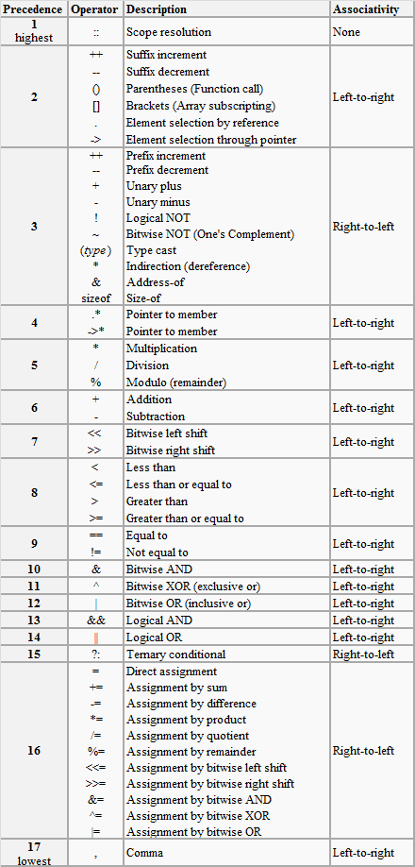
Summary of Operators – detailed precedence table

Slide 73
Example:
Show all the steps how the following expression is evaluated. Consider the initial values of i=8, j=5.
2*((i/5)+(4*(j-3))%(i+j-2))

Slide 74
Example solution:
2*((i/5)+(4*(j-3))%(i+j-2)) i→8, j→5
2*((8/5)+(4*(5-3))%(8+5-2))
2*(1+(4*2)%11)
2*(1+8%11)
2*(1+8)
2*9
18

Slide 75
Operator precedence & Associativity
Ex: (x==10 + 15 && y < 10)
Assume x=20 and y=5
Evaluation:
+ (x==25 && y< 10)
< (x==25 && true)
== (False && true)
&& (False)

Slide 76
Tutorial Problems
Suppose that a=2, b=3 and c=6, What is the answer for the following: (a==5) (a * b > =c) (b+4 > a *c) ((b=2)==a)
Evaluate the following: 1. ( (5 == 5) && (3 > 6) ) 2. ( (5 == 5) || (3 > 6) ) 3. 7==5 ? 4 : 3 4. 7==5+2 ? 4 : 3 5. 5>3 ? a : b 6. K = (num > 5 ? (num <= 10 ? 100 : 200) : 500); where num =30
In b=6.6/a+(2*a+(3*c)/a*d)/(2/n); which operation will be performed first.
If a is an integer variable, a=5/2; will return a value
The expression, a=7/22*(3.14+2)*3/5; evaluates to
If a is an Integer, the expression a = 30 * 1000 + 2768; evaluates to

Slide 77
Tutorial Problems
Suppose that a=2, b=3 , c=6 and d=5 What is the answer for the following:
(a==5) → 0
(a * b > =c) → 1
(b+4 > a *c) → 0
((b=2)==a) → 1
Evaluate the following:
( (5 == 5) && (3 > 6) ) → 0
( (5 == 5) || (3 > 6) ) → 1
7==5 ? 4 : 3 → 3
7==5+2 ? 4 : 3 → 4
5>3 ? a : b → 2
K = (num > 5 ? (num <= 10 ? 100 : 200) : 500); where num =30 → 200
In b=6.6/a+(2*a+(3*c)/a*d)/(2/n); which operation will be performed first.
If a is an integer variable, a=5/2; will return a value → 2
The expression, a=7/22*(3.14+2)*3/5; evaluates to → 0
If a is an Integer, the expression a = 30 * 1000 + 2768; evaluates to → 32768
Suppose that a=2, b=3 , c=6 and d=5 What is the answer for the following:
(a==5)
(a * b > =c)
(b+4 > a *c)
((b=2)==a)
Evaluate the following:
( (5 == 5) && (3 > 6) )
( (5 == 5) || (3 > 6) )
7==5 ? 4 : 3
7==5+2 ? 4 : 3
5>3 ? a : b
K = (num > 5 ? (num <= 10 ? 100 : 200) : 500); where num =30
In b=6.6/a+(2*a+(3*c)/a*d)/(2/n); which operation will be performed first.
If a is an integer variable, a=5/2; will return a value
The expression, a=7/22*(3.14+2)*3/5; evaluates to
If a is an Integer, the expression a = 30 * 1000 + 2768; evaluates to
Notes:
Suppose that a=2, b=3 and c=6, What is the answer for the following:
(a==5)
(a * b > =c)
(b+4 > a *c)
((b=2)==a)
Evaluate the following:
( (5 == 5) && (3 > 6) )
( (5 == 5) || (3 > 6) )
7==5 ? 4 : 3
7==5+2 ? 4 : 3
5>3 ? a : b
K = (num > 5 ? (num <= 10 ? 100 : 200) : 500); where num =30
In b=6.6/a+(2*a+(3*c)/a*d)/(2/n); which operation will be performed first.
If a is an integer variable, a=5/2; will return a value
The expression, a=7/22*(3.14+2)*3/5; evaluates to
If a is an Integer, the expression a = 30 * 1000 + 2768; evaluates to

Slide 78
Summary
We have learnt about
Arithmetic Operators
Relational and Logical Operators
Type conversions
Increment and Decrement Operators
Bitwise Operators
Assignment Operators and Conditional Expressions
Precedence and Order of Evaluation

